Slide 1
Input elements

Slide 2
Agenda
Input elements
Sample output
Input elements implementation

Slide 3
Input elements
Input elements are like scanner class in java which take input from users.
Like java scanner class input, we can also accept specific type of data like numbers, text, password, calendar radio buttons and many more.
Syntax:
<input type=”type of input you want to accept here”>

Slide 4
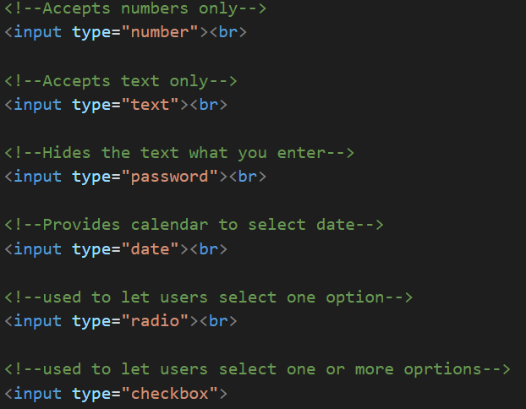
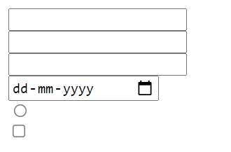
Sample Output

Slide 5
Input elements implementation
Let’s see implementation of Input elements.

Slide 6
Summary
We have seen some of the input elements used in HTML.
DO NOT WRITE ANYTHING
HERE. LEAVE THIS SPACE FOR
WEBCAM

Slide 7
Thank You
Proprietary content. ©Great Learning. All Rights Reserved. Unauthorized use or distribution prohibited

